Slide 1

Heimdall Spring Presentation
Kyle Cullion
Michael Keenan
Vivek Kunapareddy
Zack Steck
Advisor: Dr. Badri Vellambi

Slide 2
Goals
Create a free, open-source server monitoring application
Fill a niche in the server monitoring industry for this open-source solution
Current solutions are expensive to maintain
Idea came from a co-op experience in 2018
Company needed a server monitoring application for their project
Underwhelmed by current solutions

Slide 3
Intellectual Merits
Open-source is an industry term that has existed since the late 1990s
Created some of the world’s most popular software
Based on the novel idea of anyone in the world contributing to the project
Allows for some incredible collaboration towards a common goal
Worked quite well in the past 30 years
Making Heimdall open-source allows for an original contribution to the server monitoring industry, and is therefore a worthwhile venture

Slide 4
Broader Impacts
Technology isn’t perfect
As it reaches further and further across different industries, the potential impact of a system failure has risen exponentially
Server crashes, power outages, unforeseen bugs in production code
Using Heimdall allows companies to know immediately when a system goes down
Real-time metrics allow insight into expected and unexpected server behavior on different fronts for clients to further analyze for business purposes.

Slide 5
Design Specifications
Heimdall’s design consists of an agent-server relationship.
The agent, written in the Go, is installed on the end user’s desired server and proceeds to collect low-level server metrics to move via API to Heimdall’s central server.
This external facing API will securely deliver data requests and interact with the database. This backend database will be using PostgreSQL to store information sent via the agents to be fetched by the central server.
The central server will be tasked with serving various files and assets to the web-based application to display information to end users seeking their usage levels for each metric.
The API and central server architecture will be built using Node.JS, whereas the web-based application will be built using AngularJS.
The end user interacts with the web application interface to obtain their sought after metrics

Slide 6
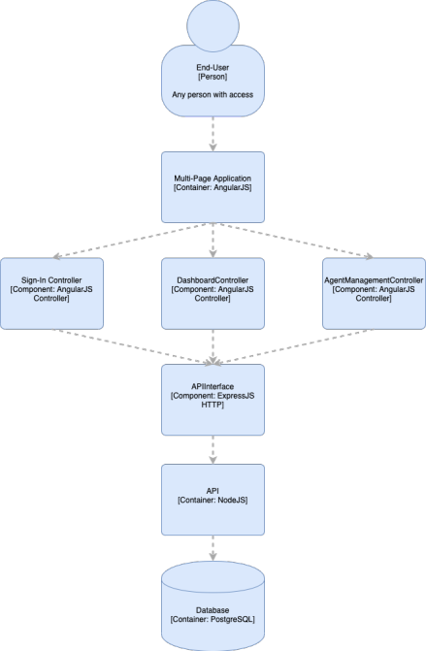
Design Diagram

Slide 7
Technologies
The entire HTTP request architecture is serviced by servers running Node.JS
The front-end is served by a Express.js framework
The back-end HTTP routes are also written in Nodejs
The front-end of the application was written in AngularJS
The front-end functions as a multi-page application, with the application view being rendered from the server on each switch.
The agents which monitors the server were written in Golang
The agents run OS specific commands to get the metrics out and then send HTTP requests to the back-end

Slide 8
Results
Completed functional server agent that is sending the specified metrics via HTTP requests
Web-app is functional with core metrics visualizations and agent management
Multiple platform compatibility for the agent software
Ability to switch between multiple registered agents along with selecting specific time frames and network adaptors to view respective metrics.

Slide 9
Demo

